Slide 1
Naive Bayes Classifiers (NBC)
J.-S. Roger Jang (張智星)
jang@mirlab.org
http://mirlab.org/jang
MIR Lab, CSIE Dept.
National Taiwan University

Slide 2
Assumptions & Characteristics
Assumptions:
Statistical independency between features
Statistical independency between samples
Each feature governed by a feature-wise parameterized PDF (usually a 1D Gaussian)
Characteristics
Simple and easy (That’s why it’s named “naive”.)
Highly successful in real-world applications regardless of the strong assumptions

Slide 3
Training and Test Stages of NBC
Quiz!
Training stage
Identify class PDF, as follows.
Identify feature PDF by MLE for 1D Gaussians
Class PDF is the product of all the corresponding feature PDFs
Test stage
Assign a sample to the class by taking class prior into consideration:

Slide 4
NBC for Gender Dataset (1/2)
Scatter plot of Gender dataset
PDF on each features and each class

Slide 5
NBC for Gender Dataset (2/2)
PDF for each class
Decision boundary

Slide 6
NBC for Iris Dataset (1/3)
Scatter plot of Iris dataset (with only the last two dim.)
PDF on each features and each class

Slide 7
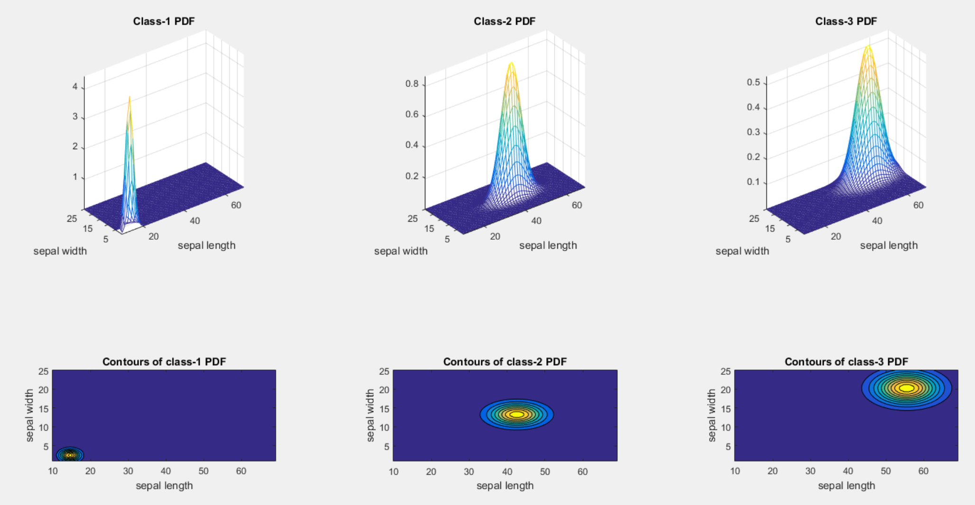
NBC for Iris Dataset (2/3)
PDF for each class

Slide 8
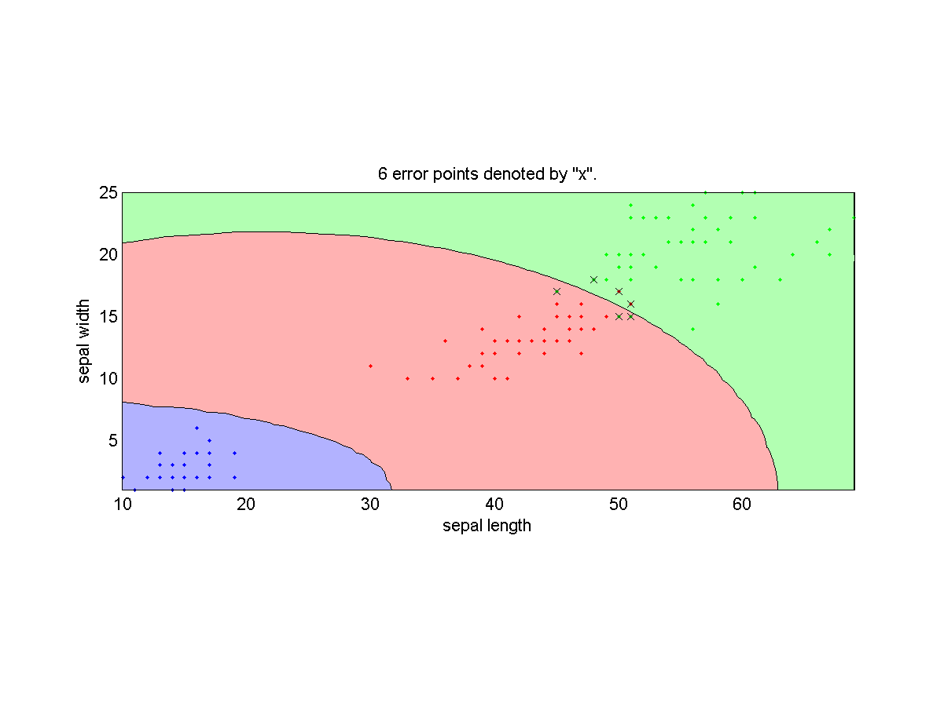
NBC for Iris Dataset (3/3)
Decision boundaries (using the last 2 features)

Slide 9
Strength and Weakness of NBC
Quiz!
Strength
Fast computation during training and evaluation
Robust than QC
Weakness
No able to deal with bi-modal data correctly
Class boundary not as complex as QC

